Slide 1

WELCOME

Slide 2
PROJECT TITLE
Search exam result through
client /server architecture
Presented by,
M.vijay babu
Regd.no:06H51F0057.

Slide 3
INTERNAL GUIDE:
A.SWETHA
Associative Professor,
MCA Department,
CMRCET
EXTERNAL GUIDE:
ARUN HEGDE
S/W ENGINEER.
TechSol

Slide 4

ORGANISATION PROFILE:
TECHSOL
TechSol is leader in IT industry and has been providing creative software solutions for businesses of all sizes.
TechSol is committed to delivering world-class technology solutions to a virtually integrated business community .
Our goal is to implement our process driven methodologies for the rapid deployment of business functionality .

Slide 5
OVERVIEW:
The project “Search exam result through client /server architecture” is designed using Microsoft Visual Studio.Net 2005 as front end and Microsoft SQL Server 2000 as Back end.
By having system such as this one, the burden on the campus administration can be reduced, as the students will no longer have to go the administration office to obtain their result.
The distributed Examination Result Information System will allow students to view their respective exam result from any workstation in the faculty.

Slide 6
EXISTING SYSTEM:

Slide 7
PROPOSED SYSTEM:
By having system such as this one, the burden on the campus administration can be reduced.
The students will no longer have to go the administration office to obtain their result.

Slide 8
MODULES:
It mainly consists of four modules :
Registration
Login
Exam
Result

Slide 9
Module Description
REGISTRATION:
Here desired username and password should give.
Here the candidates can register their particular information to take the test.

Slide 10
LOGIN:
Candidates can login to take the test by giving username and password.
This will take particular user to their home page.

Slide 11
EXAM:
User can take the test, answering the
questions by clicking on the radio buttons.

Slide 12
RESULTS:
        Here, result shows the marks got to a
        particular person by giving the user ID

Slide 13
FEATURES:
This project is a pilot study on how the client/server system operates. The distributed Examination Result Information System will allow students to view their respective exam result from any workstation in the faculty.

Slide 14
SOFTWARE REQUIREMENTS
Operating System : Windows xp/2003
Front-End : C#
Back-End : Sql Server 2000

Slide 15
Hardware Requirements
Pentium processor ------ 233MHZ or above
RAM Capacity ------ 128MB
Hard Disk ------ 20GB
Floppy disk ------ 1.44 MB
CD-ROM Drive ------ 32 HZ

Slide 16
UML DIAGRAMS

Slide 17
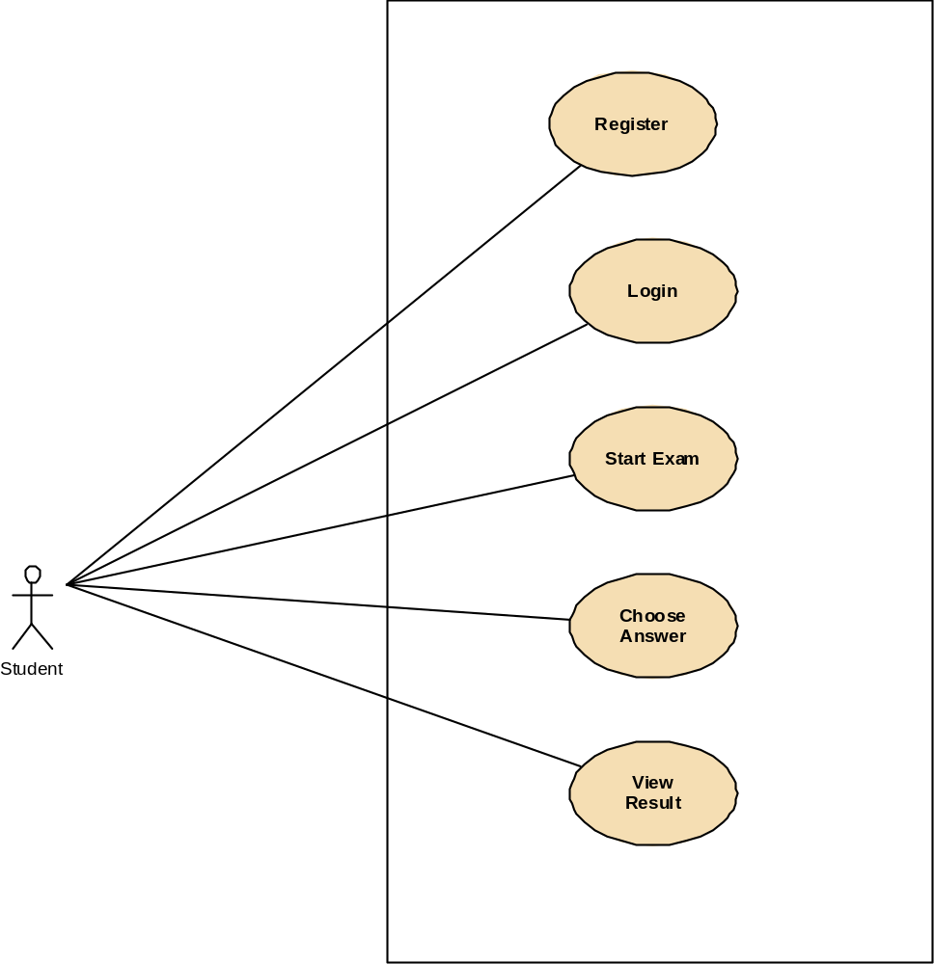

Slide 18
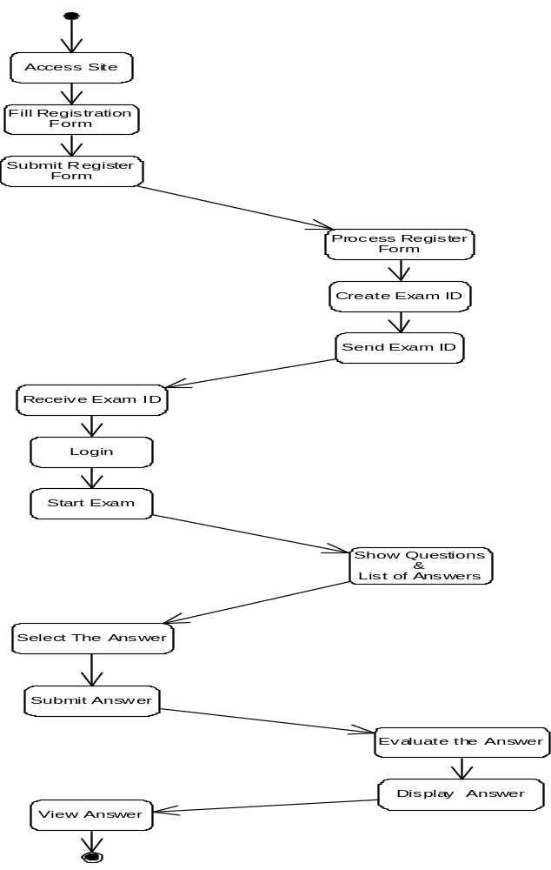

Slide 19
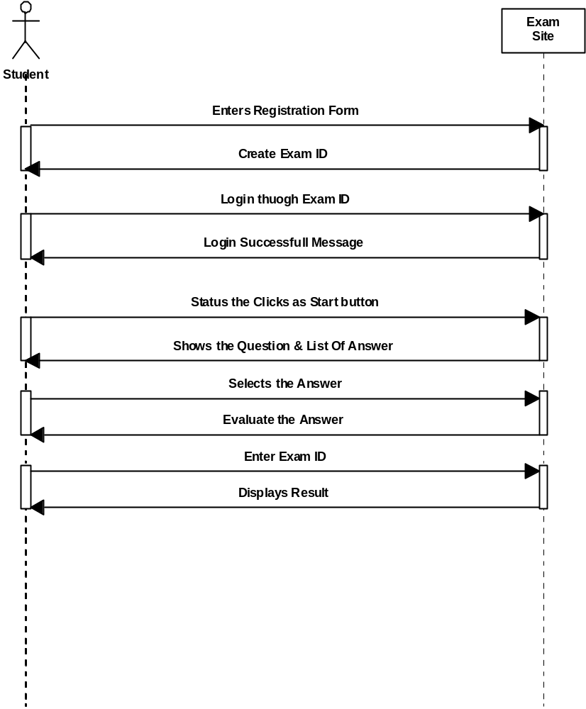

Slide 20
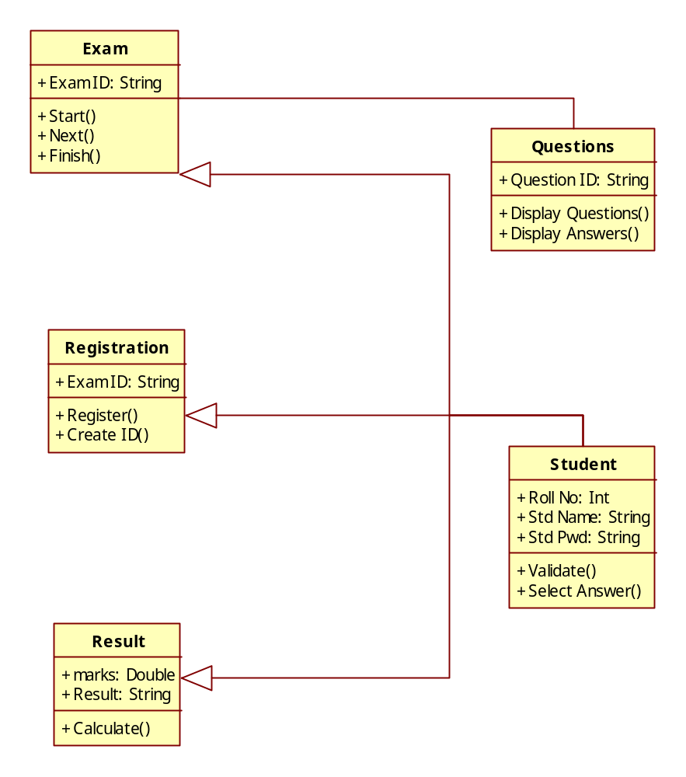

Slide 21
SCREENS SHOTS

Slide 22
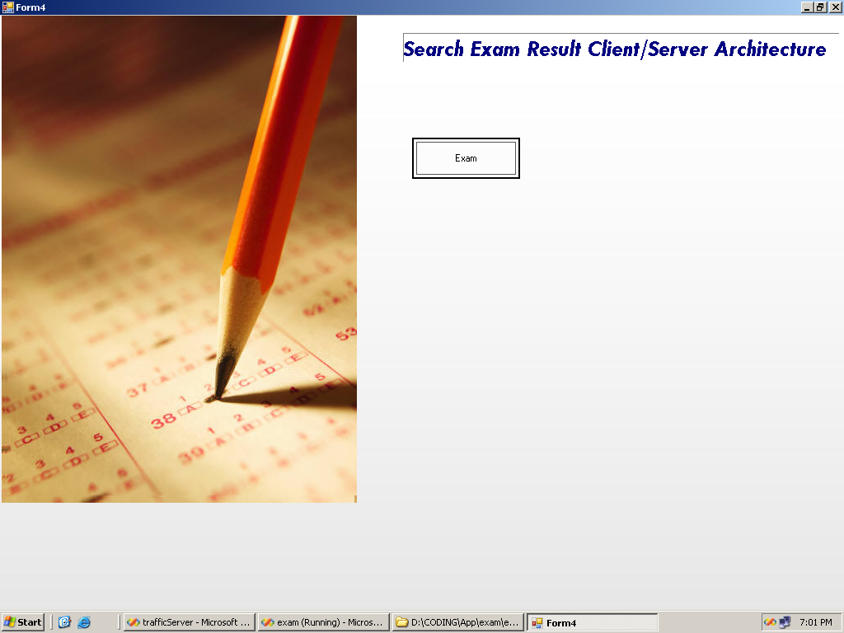

Slide 23
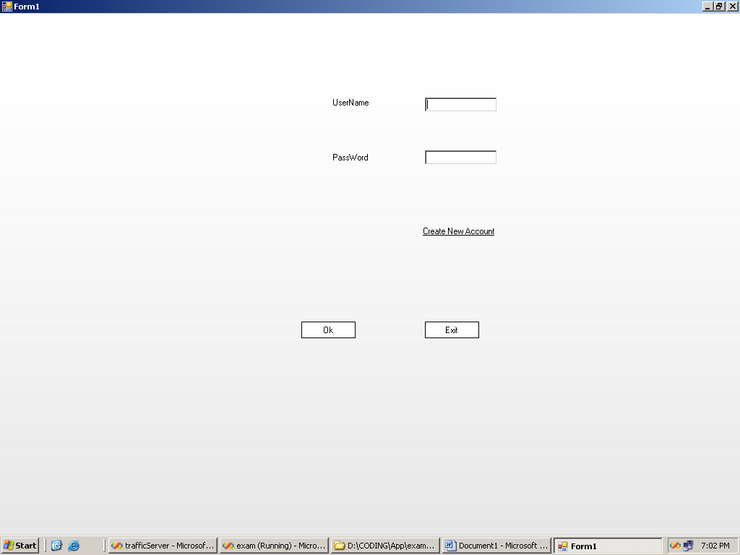

Slide 24
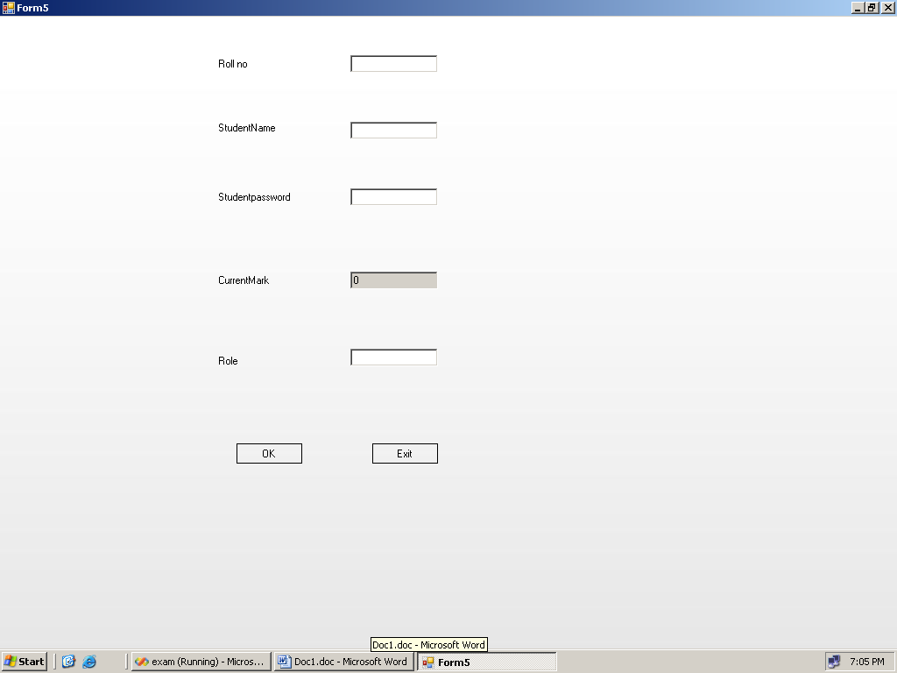

Slide 25
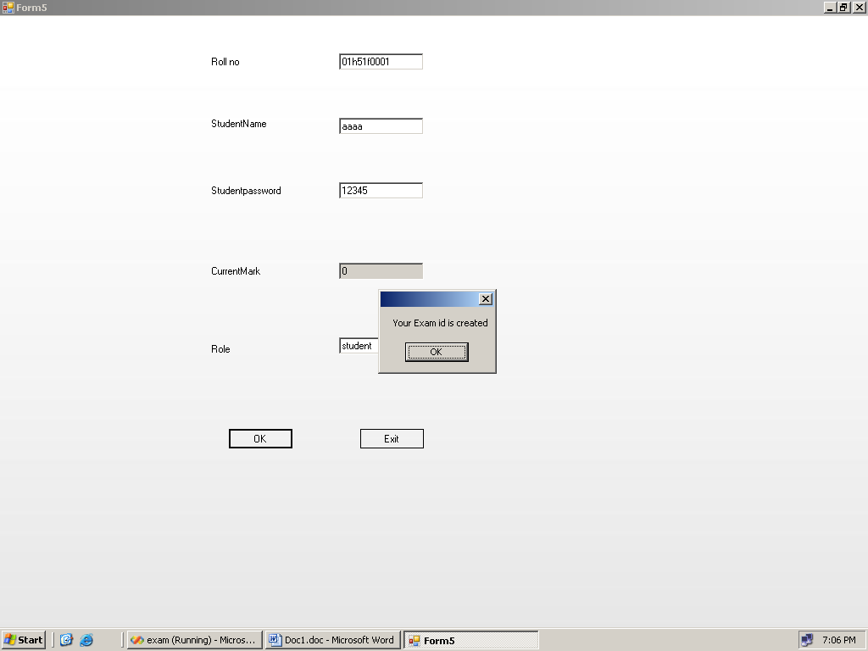

Slide 26
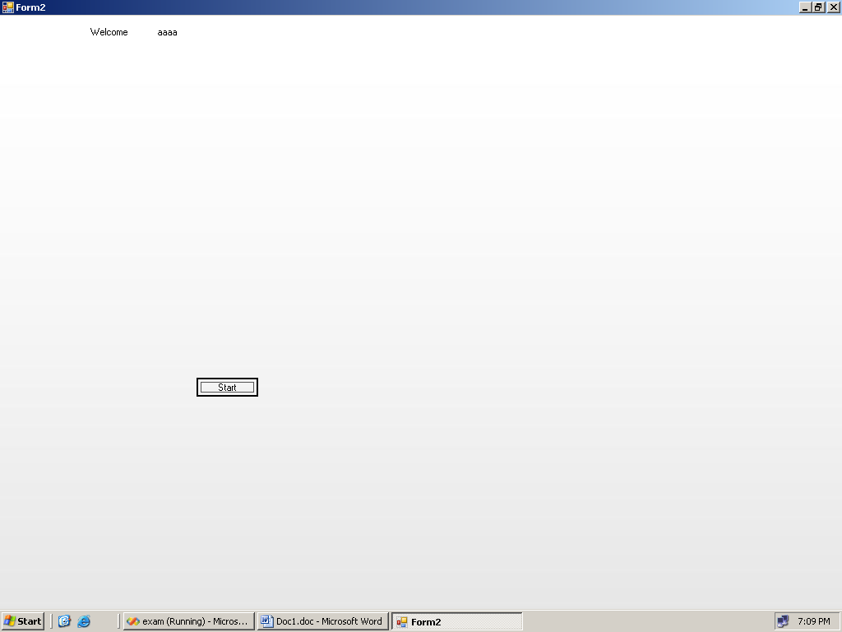

Slide 27
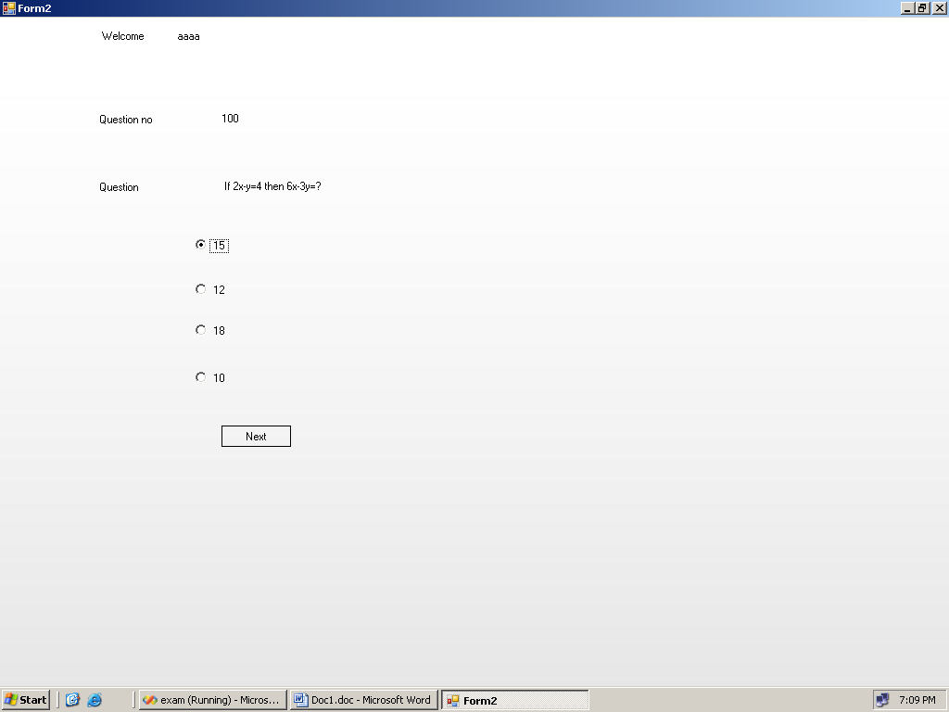

Slide 28
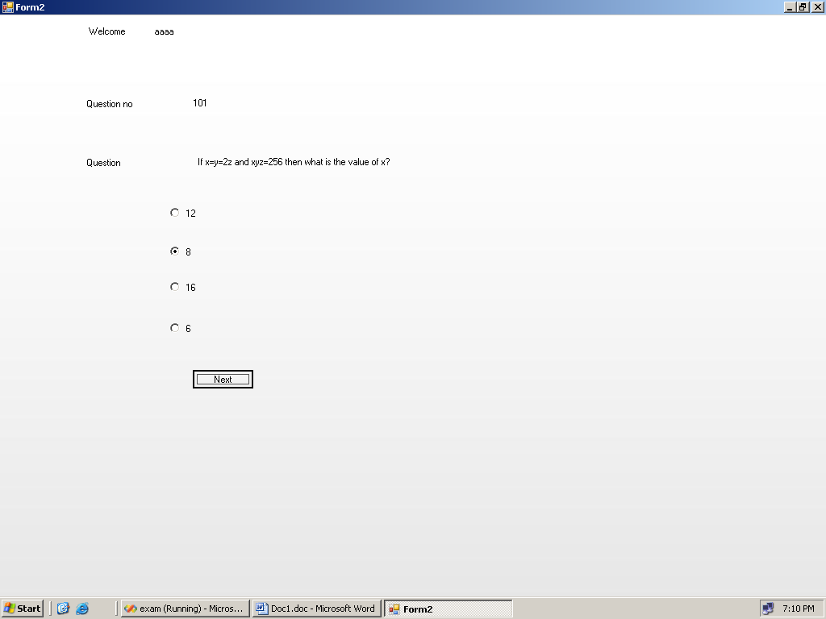

Slide 29
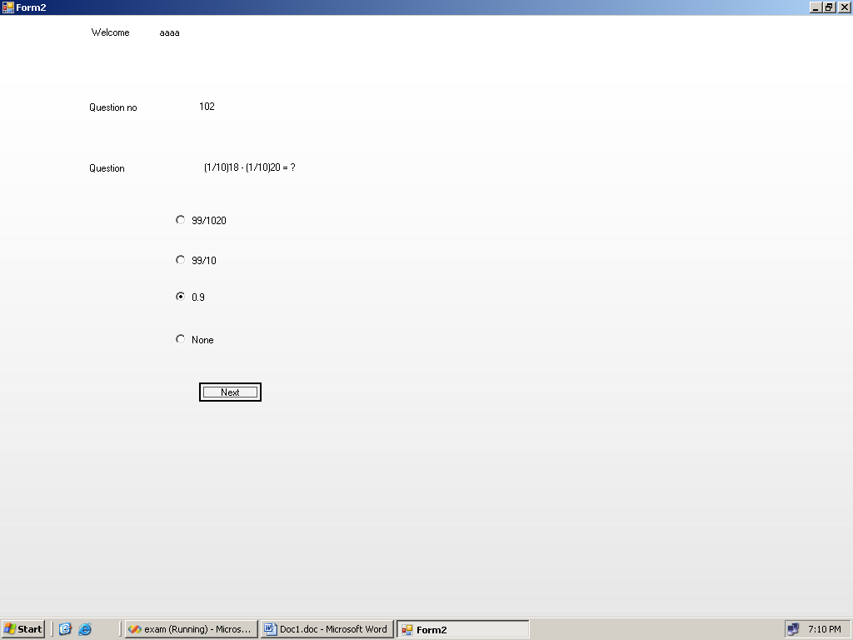

Slide 30
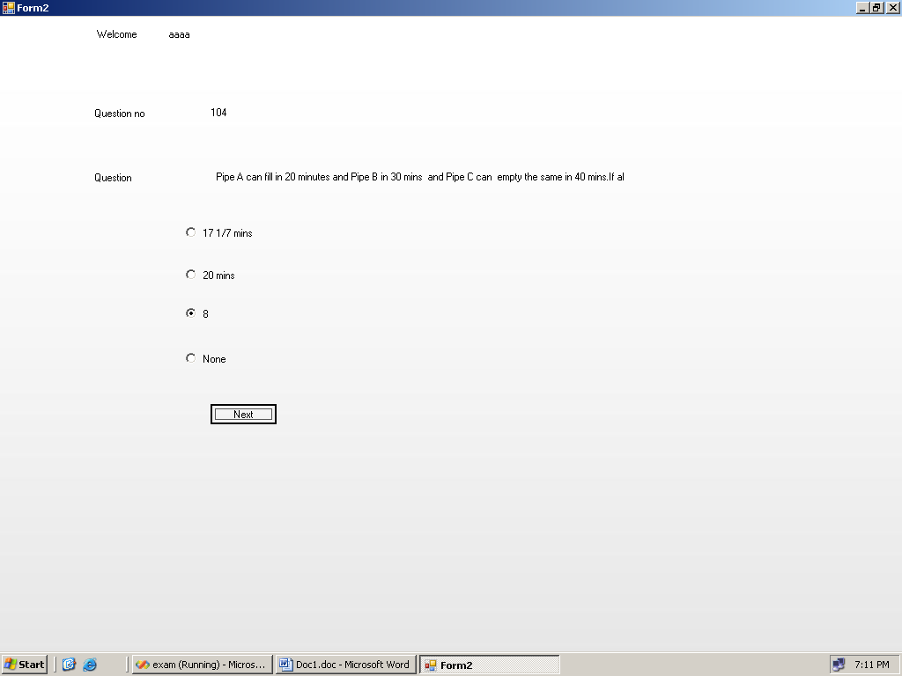

Slide 31
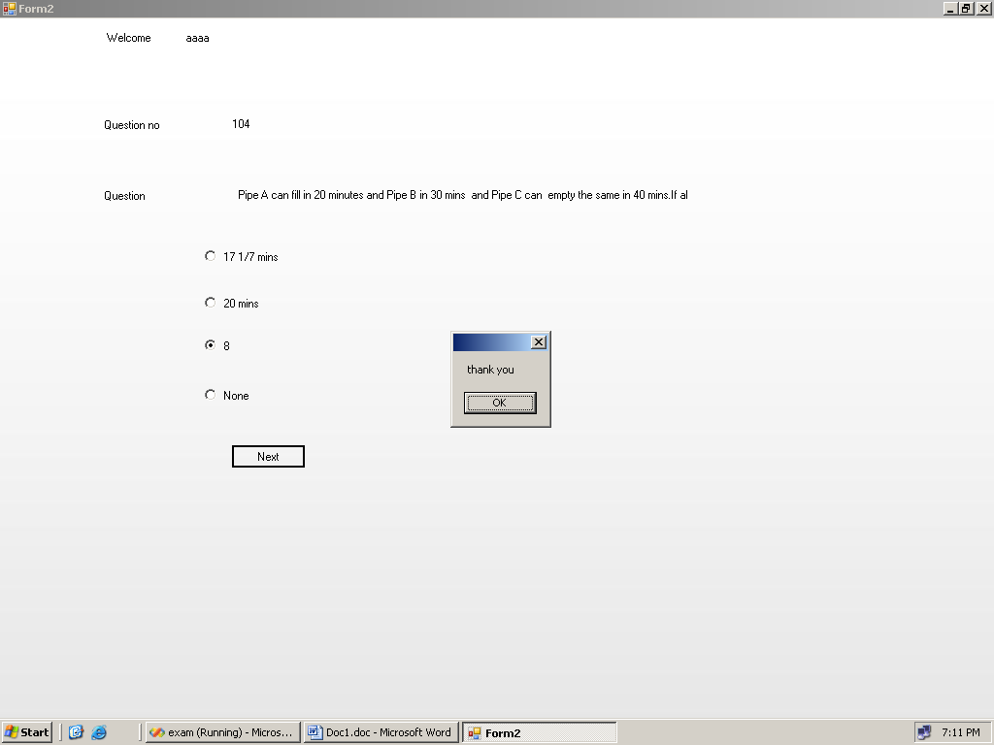

Slide 32
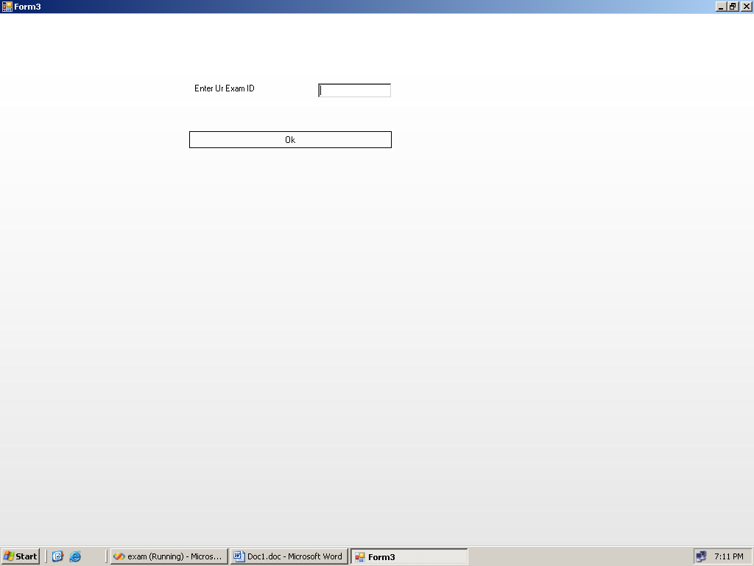

Slide 34
Thank You

